Slide 1


Safe Bus System
School of Business
Management Information System Department
Safe Bus System

Slide 2

Safe Bus System
System Analysis
& Design

Slide 3
OUTLINE
1
Introduction
2
The problem
3
Proposed Solution
4
Costs and Feasibility
5
Added value
6
Context Diagram
7
Data Flow Diagram
8
Target group
9
Prototype
10
Group members

Slide 4

1
Introduction
The Safe Bus System is an innovative idea to improve transportation services within the university. It facilitates the process of tracking buses, updating routes, choosing the most efficient routes, and setting accurate times to reduce congestion. It also pays attention to protecting the privacy of users, whether students or drivers, and provides continuous alerts to keep everyone informed. The system relies on modern technologies to monitor the performance of buses and drivers and issue comprehensive reports, making the transportation experience within the university organized and safe.
Notes:
As the system and the privacy of users' data, whether passengers or drivers, while ensuring data quality, especially during training periods. It is also characterized by its availability to issue alerts and important updates to the school, which helps students and drivers stay informed.
The project relies on modern and advanced technologies in the field of transportation, such as monitoring performance and issuing comprehensive reports on drivers and buses. Through this integration, Safe Bus System contributes to the specified time, allows management of what is inside, in addition to an organized transportation experience and campus campus, making it an ideal solution for universities where its services are available.

Slide 5
2
The Problem
Student problems on the bus:
1- Irregular bus schedules.
2- Buses are crowded with more than the permitted number.
3- Air conditioning and cleanliness problems inside the buses and the lack of additional services such as Wi-Fi chargers.
4- Drivers' speed and not waiting for late students.
5- Students losing their belongings inside the buses and lack of safety inside the bus.
6- Lack of communication between the driver and the student if they arrive.
7- The driver is not sure that the student personally got on the correct bus.
8- The driver makes sure that the student gets off the bus.

Slide 6
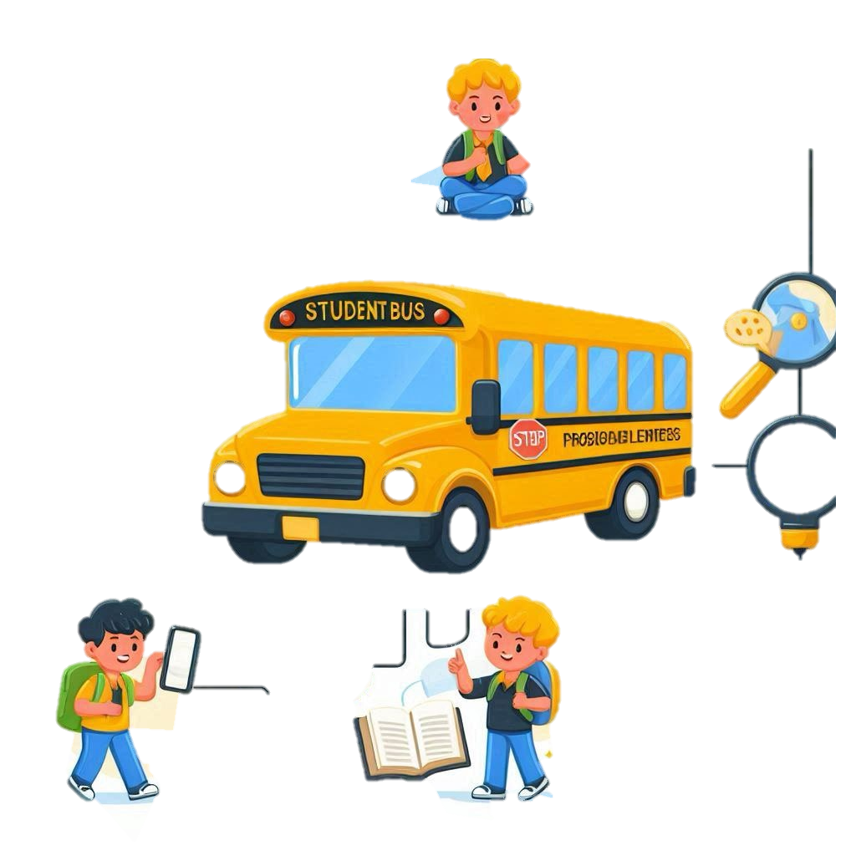
3
Proposed Solution
1- Organize specific times for bus arrival and departure.
2- Determine the number of passengers based on the number of seats and provide a designated space for wheelchairs.
3- Improve air conditioning and cleanliness inside buses.
4- Add a feature to track buses by parents and students.
5- Use university cards to identify students and ensure that only registered students use buses.
6- Receive notifications when the bus arrives at the station or to homes.
7- Enhance safety inside the bus and link it with the security department to avoid problems.
8- Set a suitable price that the student can afford and offer discounts.
~
SO_KSAUHS

Slide 7
4
Costs and feasibility
Feasibility:
Technical: Based on proven technologies; easily scalable.
Economic: Reduces long-term costs with optimized routes and efficiency.
Social: Improves convenience and safety, gaining user acceptance.
Environmental: Lowers carbon footprint with better route planning.
Implementation: Phased rollout ensures smooth integration.
Costs:
Initial Costs: Software development, hardware installation, and training.
Operational Costs: Maintenance, data storage, and fuel/energy.
Additional Investments: Expanding features like apps or analytics.
~
SO_KSAUHS

Slide 8
5
Added value
Improved Efficiency: Optimized routes and reduced travel time.
Safety and Privacy:
Protects passenger and driver data with real-time alerts
Flexibility and Customization:
Adjusts schedules and routes based on demand.
Monitoring and Reporting:
Tracks performance and provides comprehensive reports.
Cost Reduction:
Reduces fuel consumption and enhances user satisfaction.
Effective Communication:
Provides updates and alerts to all users.
Better Organization:
Ensures a reliable and well-organized campus transport system.
~
SO_KSAUHS
<..J'prul <.]l.£g.il cl.Jg
~1,:;~~~r.4J:c...~~ci.dl~l;J

Slide 9
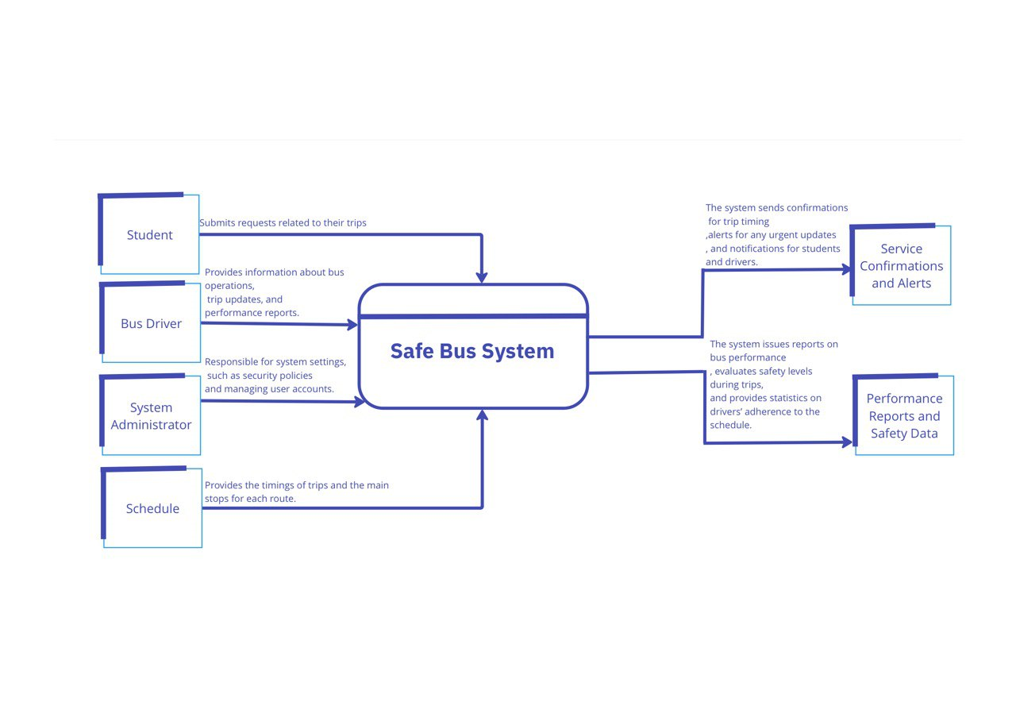
6
Context Diagram
~
SO_KSAUHS
<..J'prul <.]l.£g.il cl.Jg
~1,:;~~~r.4J:c...~~ci.dl~l;J

Slide 10
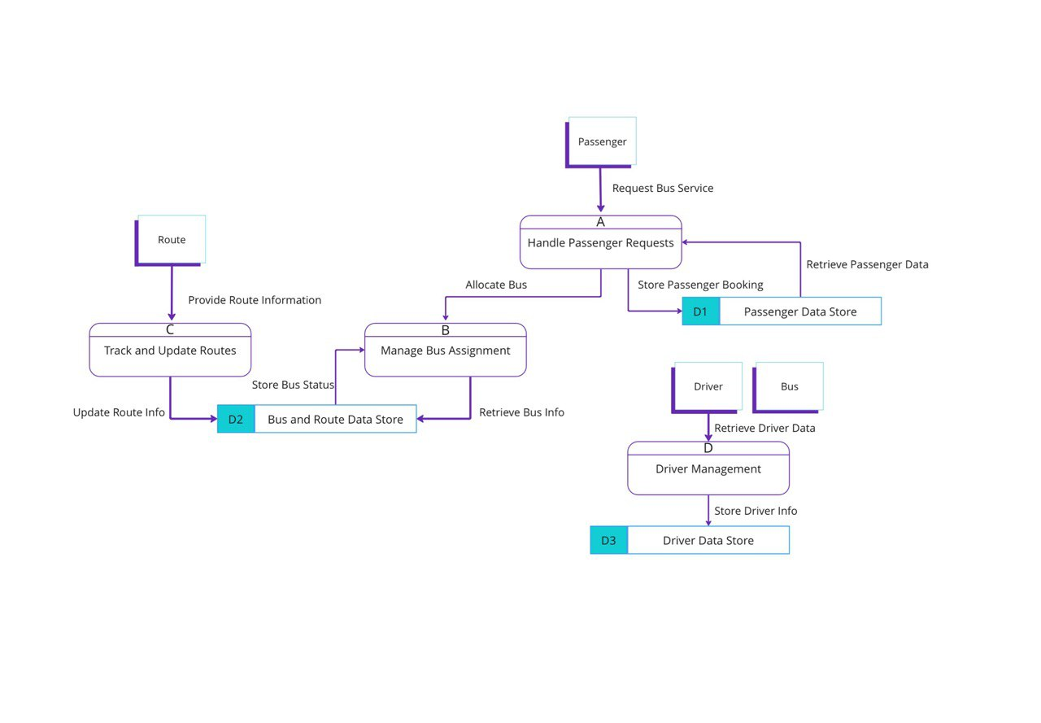
7
Data Flow Diagram
~
SO_KSAUHS

Slide 11
8
Target group
Bus Drivers:
Individuals responsible for operating the buses, benefiting from features such as real-time route updates, congestion alerts, and performance monitoring.
University Administration:
Departments managing campus transportation, looking for solutions that optimize transit operations, ensure data privacy, and provide analytics for better decision-making.
Visitors to the Campus:
Guests, parents, and attendees of university events who need access to organized and user-friendly transport.
University Students:
Those who use campus transportation to attend classes, events, and other university activities.
Students who prioritize a reliable, safe, and efficient transport experience.
University Staff and Faculty:
Professors, administrators, and other staff who require a convenient and timely mode of transport within the campus.
~
SO_KSAUHS

Slide 12
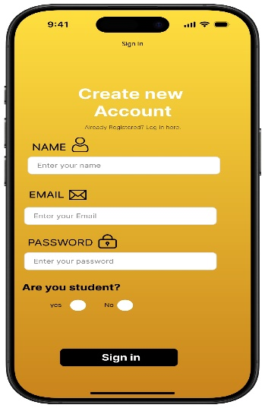
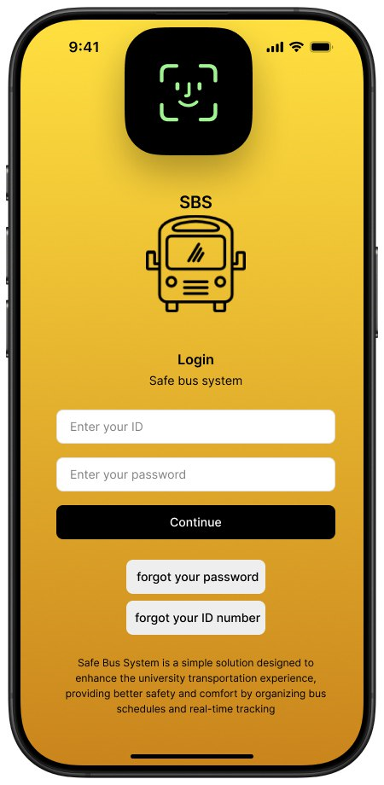
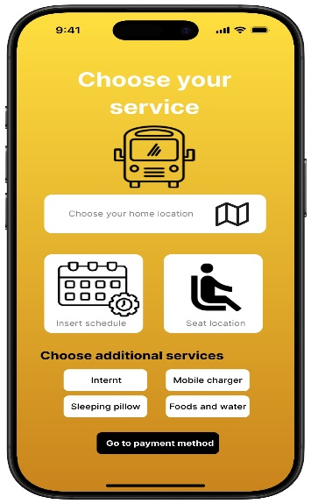
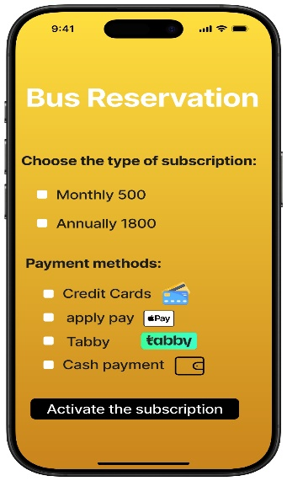
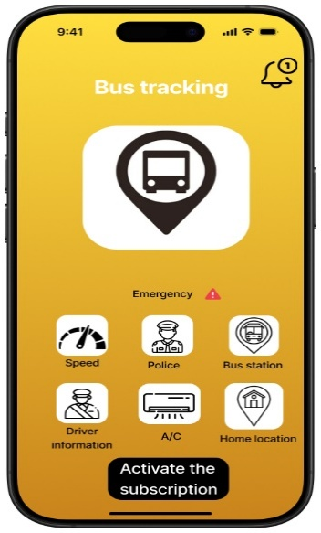
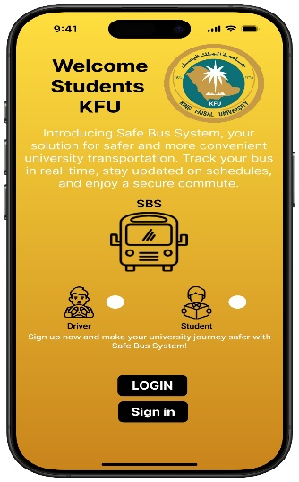
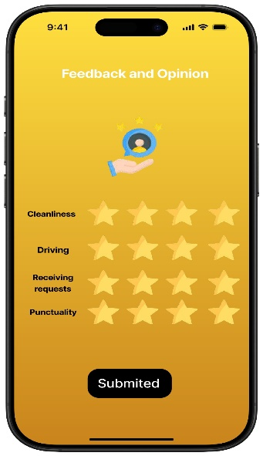
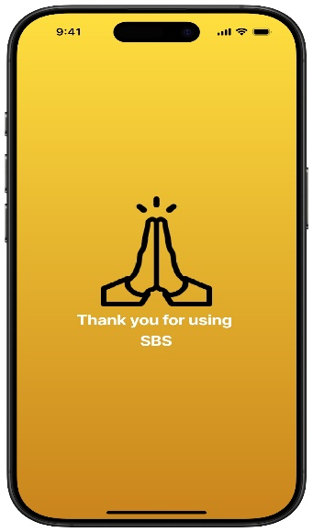
9
Prototype
~
SO_KSAUHS
<..J'prul <.]l.£g.il cl.Jg
~1,:;~~~r.4J:c...~~ci.dl~l;J

Slide 13
9
Group Members
~
SO_KSAUHS

Slide 14
THANK YOU

